Slide 1
Equilibrium Propagation
as an Alternative Algorithm
for Training Artificial Neural Networks
Group: Exciting Equilibrium Enthusiast from Pod Trustworthy Heliotrope
Members: Kyungmi Noh, Hualong Zhang, Chenyan Lu, Romain Renard, Jiaxin (Cindy) Tu,

Slide 2
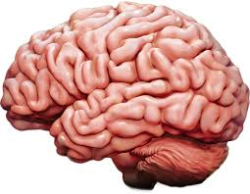
Biological plausibility and artificial neural networks
Forward pass
VS
Backward pass
Energy efficient
Requires less labeled data
Brain
ANN
Notes:
Kyungmi

Slide 3
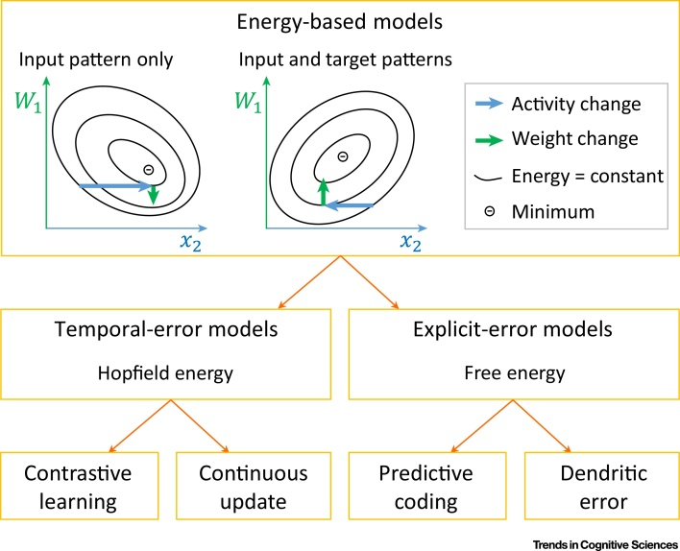
How does equilibrium propagation work?
Whittington & Bogacz et al. 2019
Notes:
Kyungmi

Slide 4
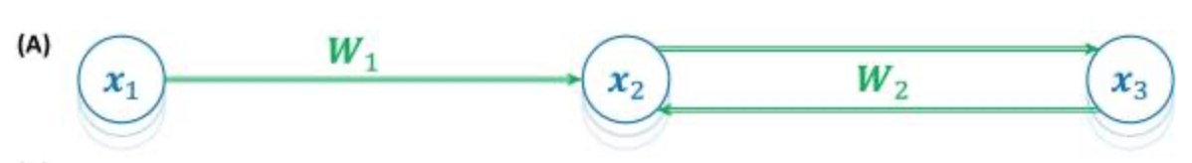
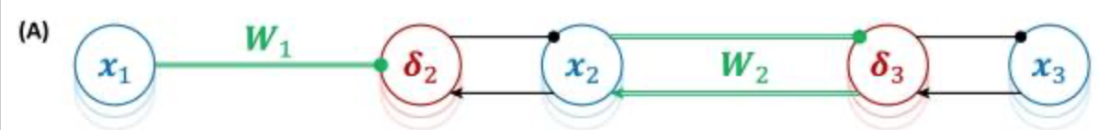
Energy-based models
MNIST error %: ~2-3 - 1.7 1.96
error
Minimize free energy by minimizing explicit error
between target & predicted
Energy to converge to a stable state
that accurately represents the input pattern
Whittington & Bogacz et al. 2019

Slide 5
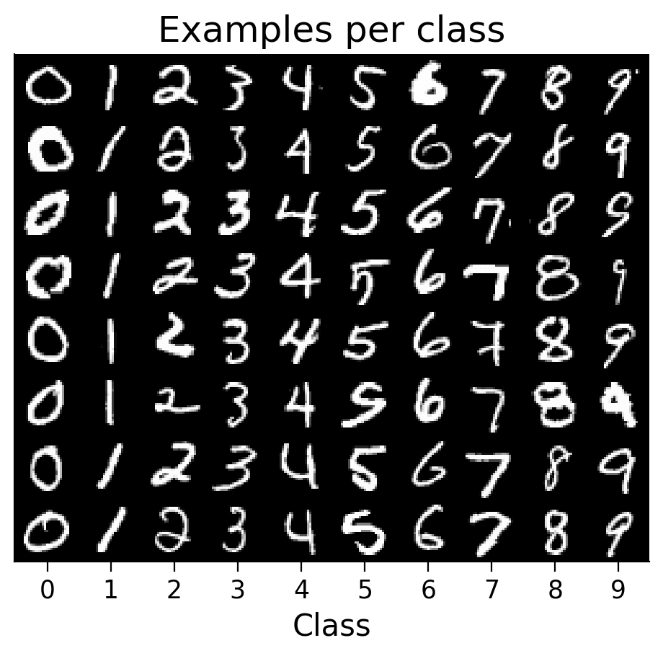
Experiments
Dataset: MNIST (handwritten digits)
Training data: 54000 samples
Validation data: 6000 samples
Test data: 10000 samples
Task: classification of the 10 digit classes
Model architecture:
Feed-forward, two layers
(0): Linear(in_features=784, out_features=1000, bias=True)
(1): Linear(in_features=1000, out_features=10, bias=True)
Update rule:
Back Propagation (BP)
Equilibrium Propagation (EP)
Restrictive Hopfield (RH)
Conditional Gaussian (CG)
Notes:
Hualong

Slide 6
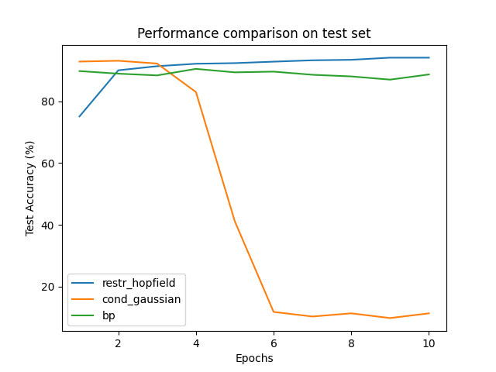
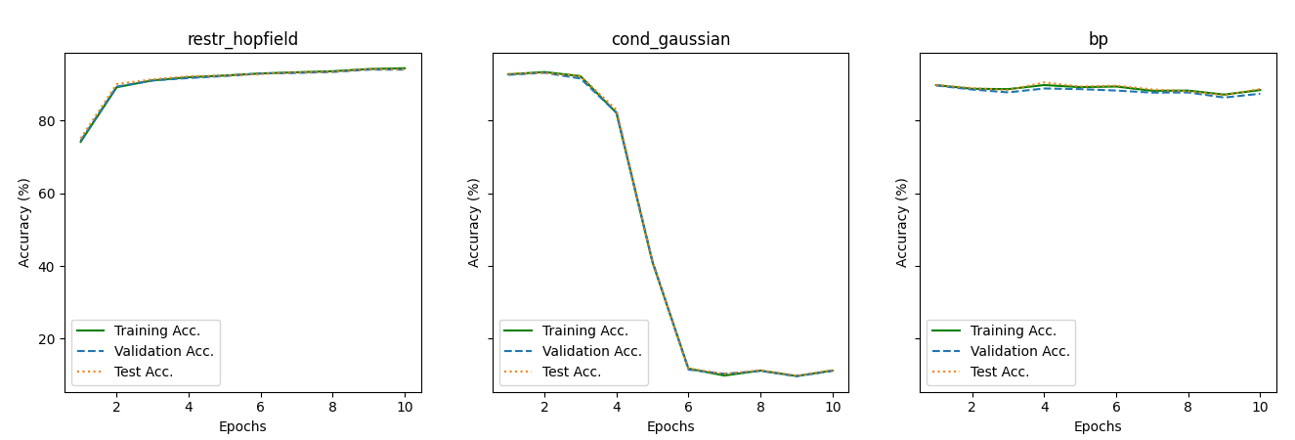
Q1: Do the equilibrium propagation algorithm learn as well as the back propagation?
* Using N = 54000 training samples
Conclusion:
Equilibrium propagation algorithms were able to achieve about the same training performance as the back propagation algorithm, but conditional gaussian performance dropped after a few epochs.
Notes:
Chenyan

Slide 7
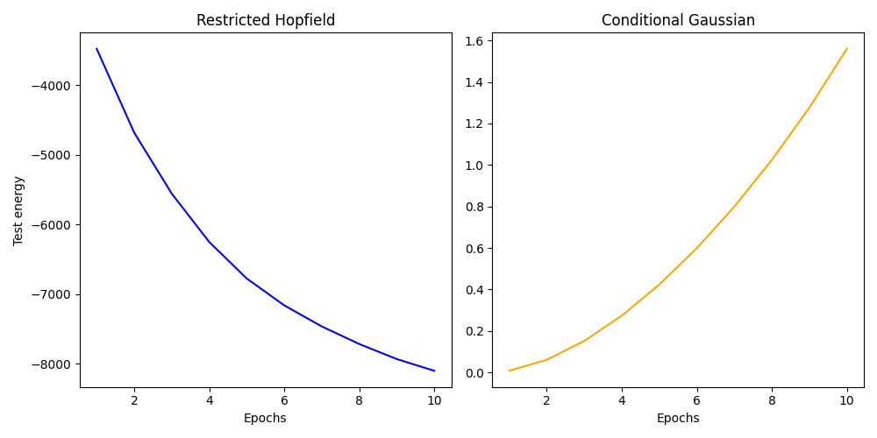
Q2: How does energy change with training?
Conclusion:
Test energy decreased with training in restrictive hopfield and increased with training in conditional gaussian.
Notes:
Chenyan

Slide 8
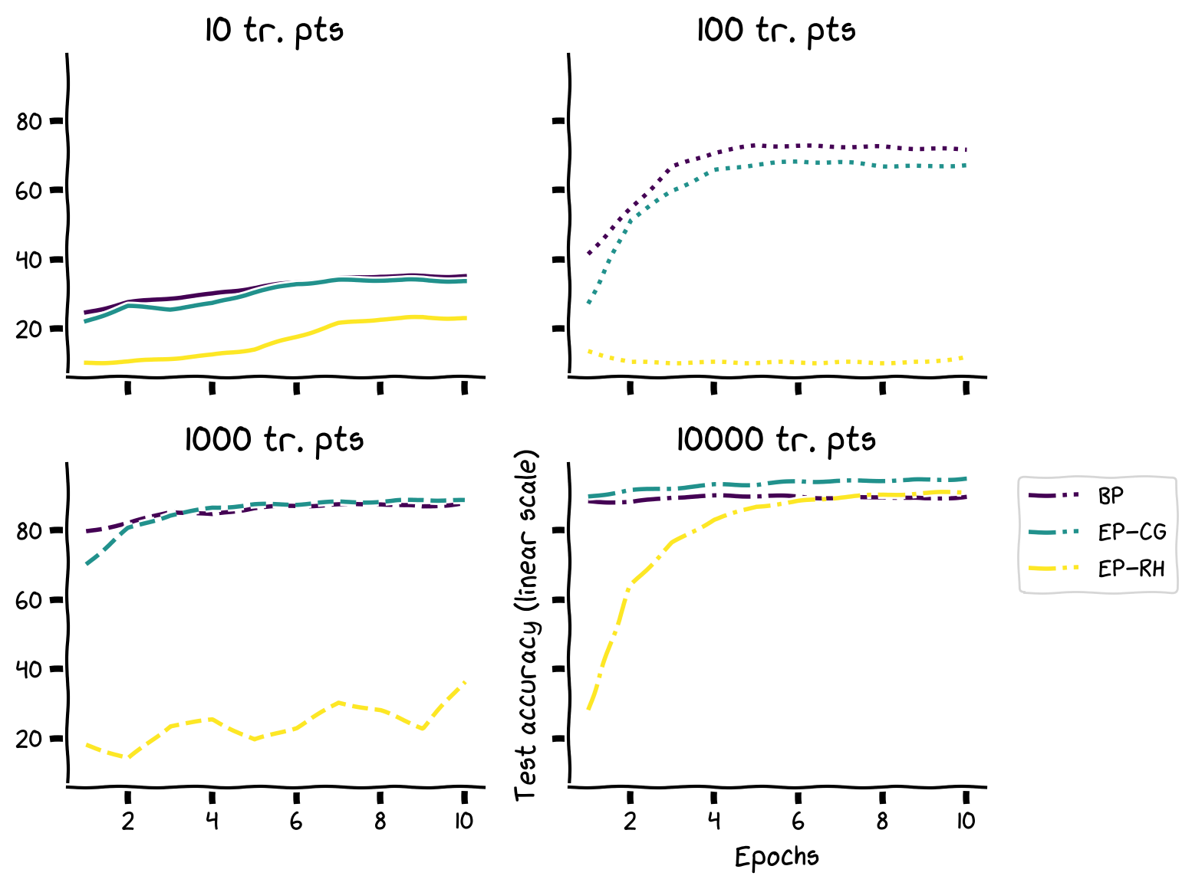
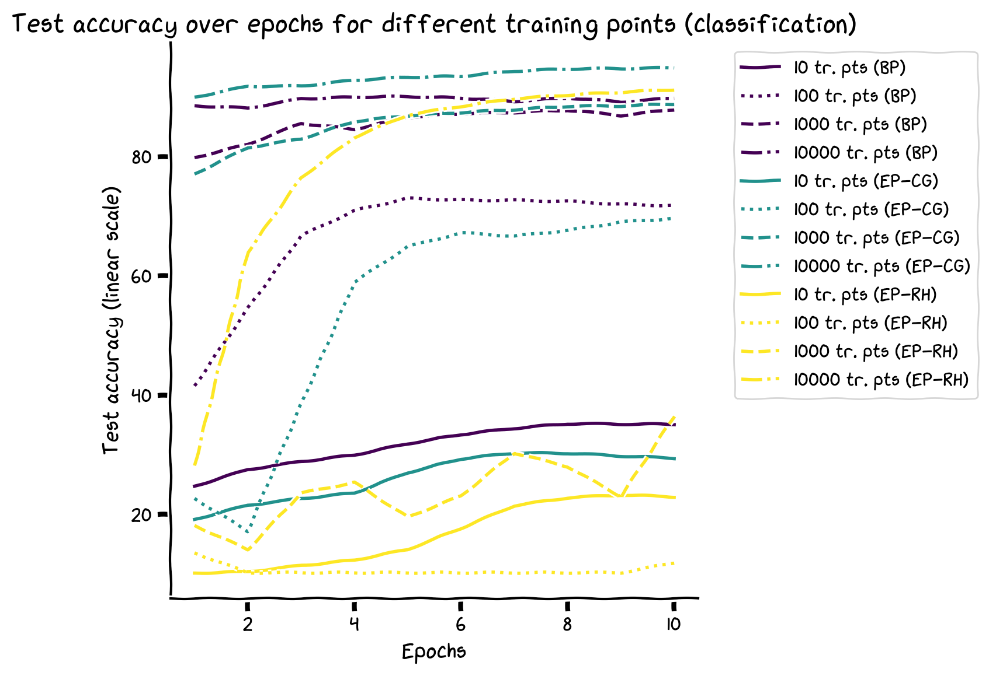
Q3: Do the equilibrium propagation algorithm learn as well as the back propagation for small data samples?
* Using N = 10, 100, 1000, 10000 training samples
Test accuracies
Conclusion:
Equilibrium propagation algorithms were able to achieve the same training performance as the back propagation algorithm when enough training samples are provided, but failed with small training samples.
Notes:
Romain

Slide 9
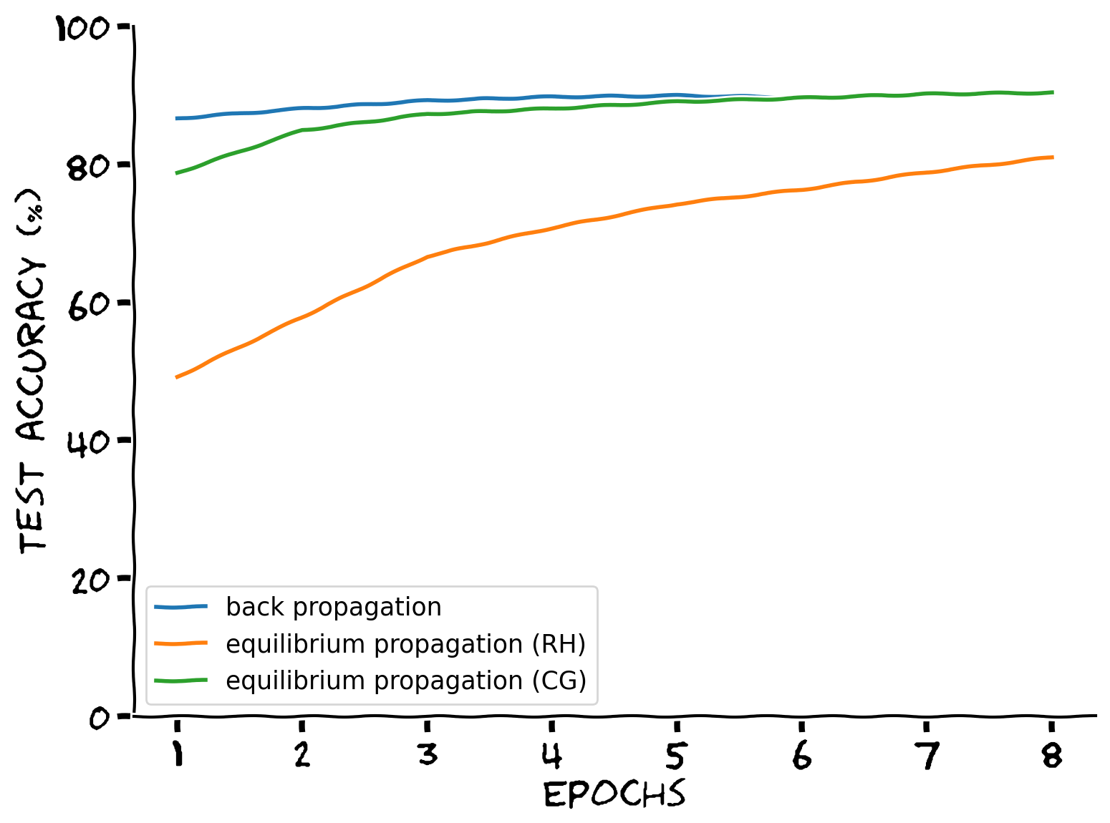
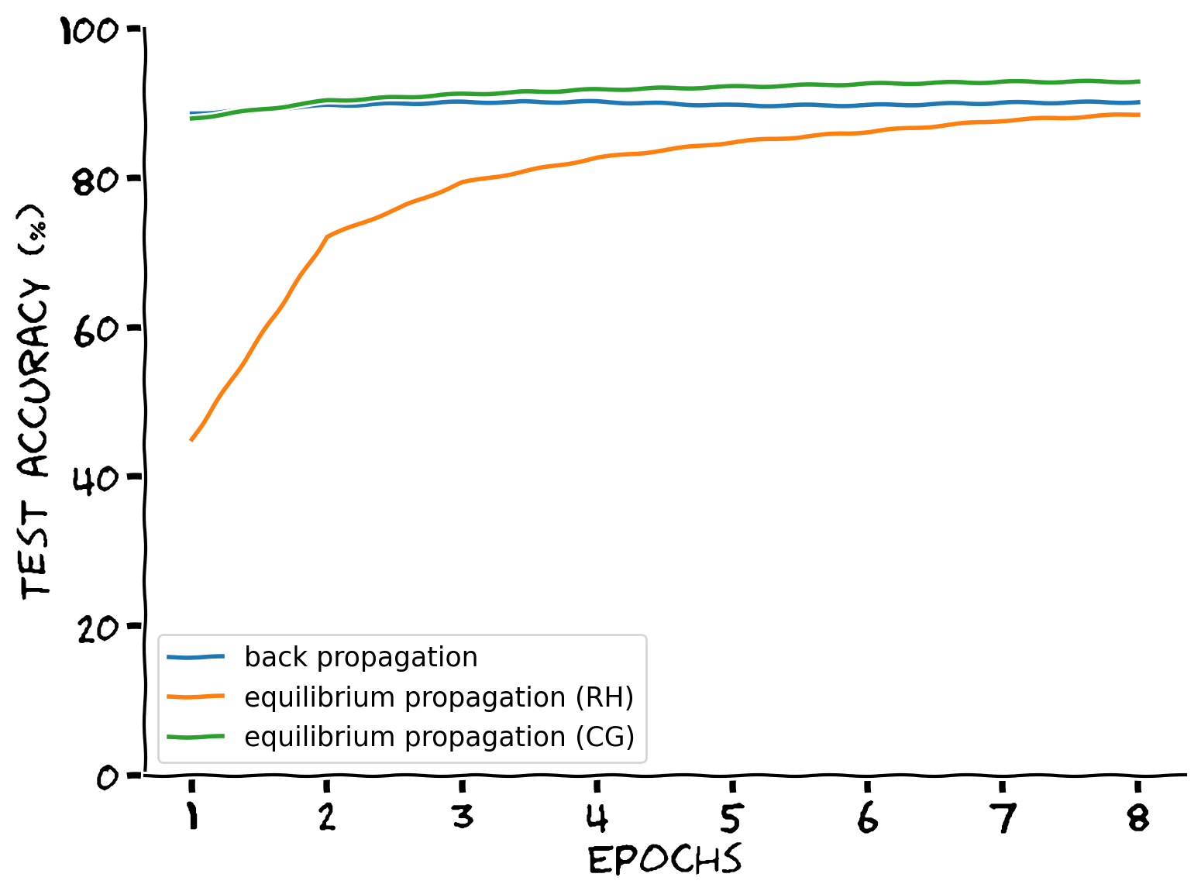
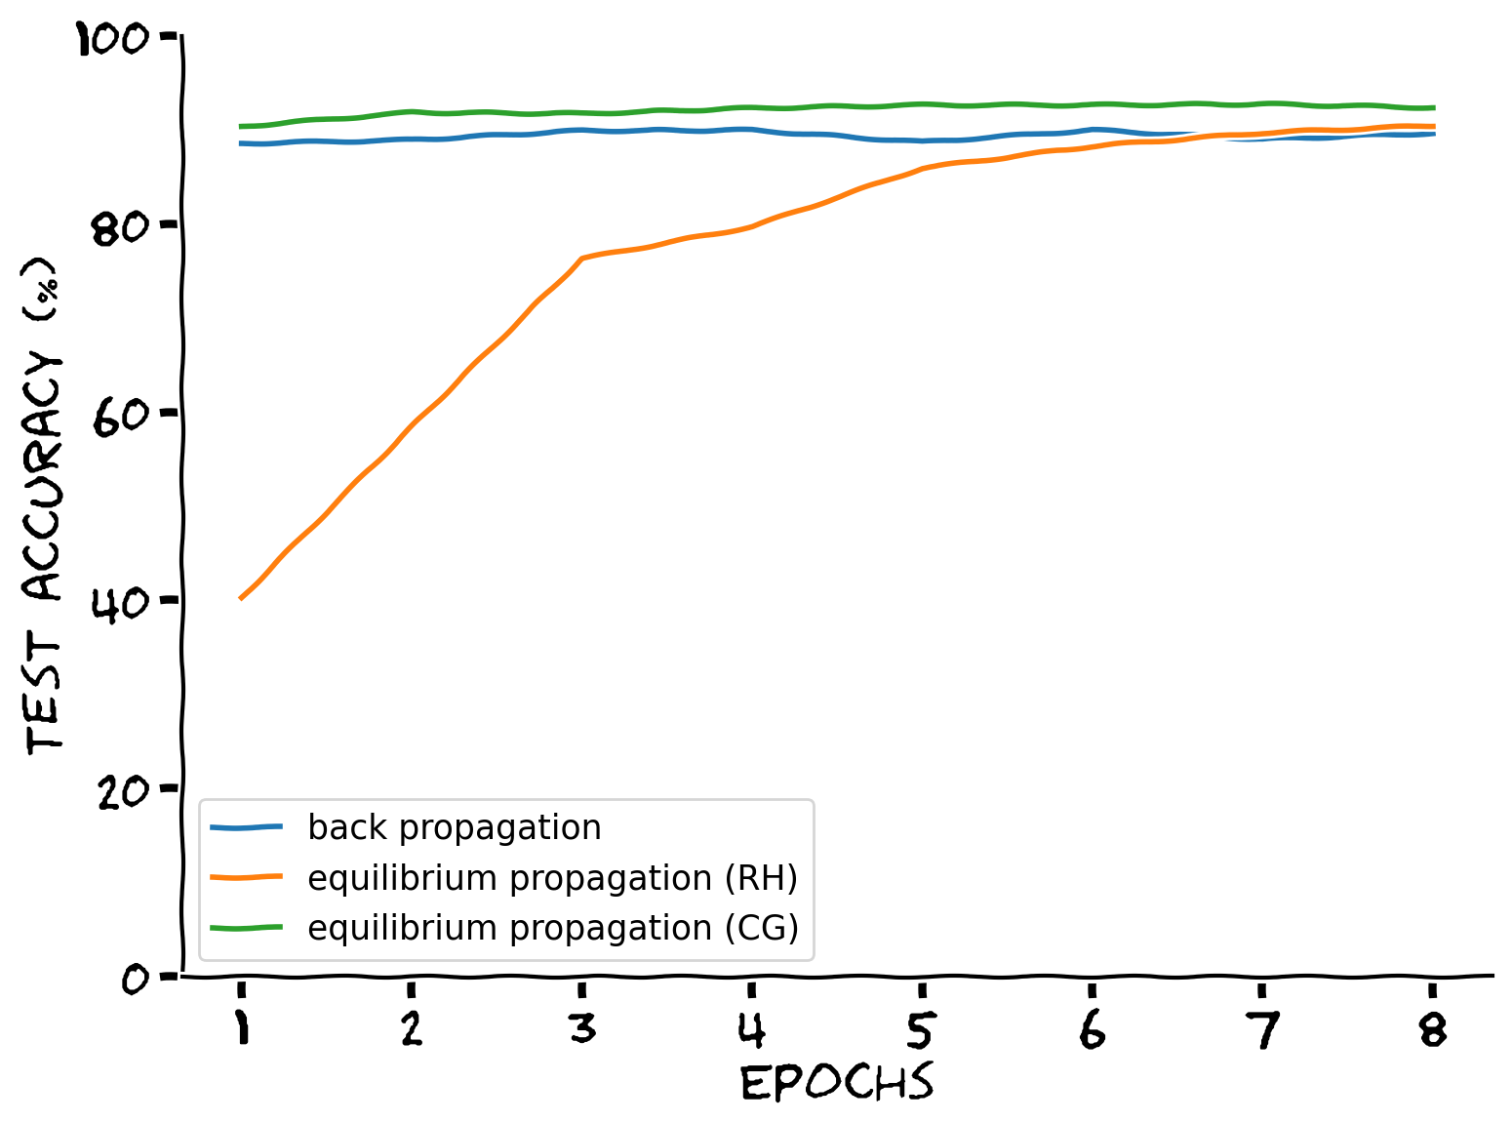
Q4: Do the different algorithms have different sensitivity to the number of hidden units?
* Using N = 10000 training samples
20 hidden units
100 hidden units
1000 hidden units
Conclusion:
Both equilibrium propagation algorithms were able to increase performance with more hidden units.
Notes:
Cindy

Slide 10
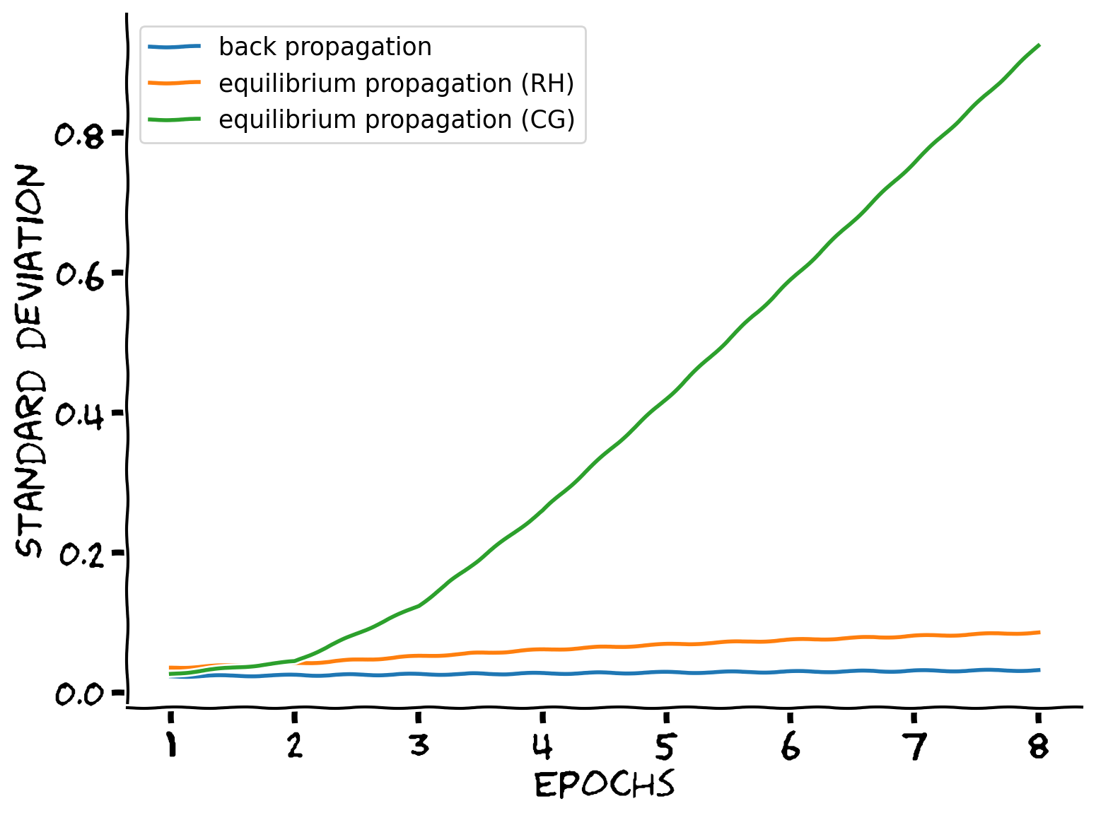
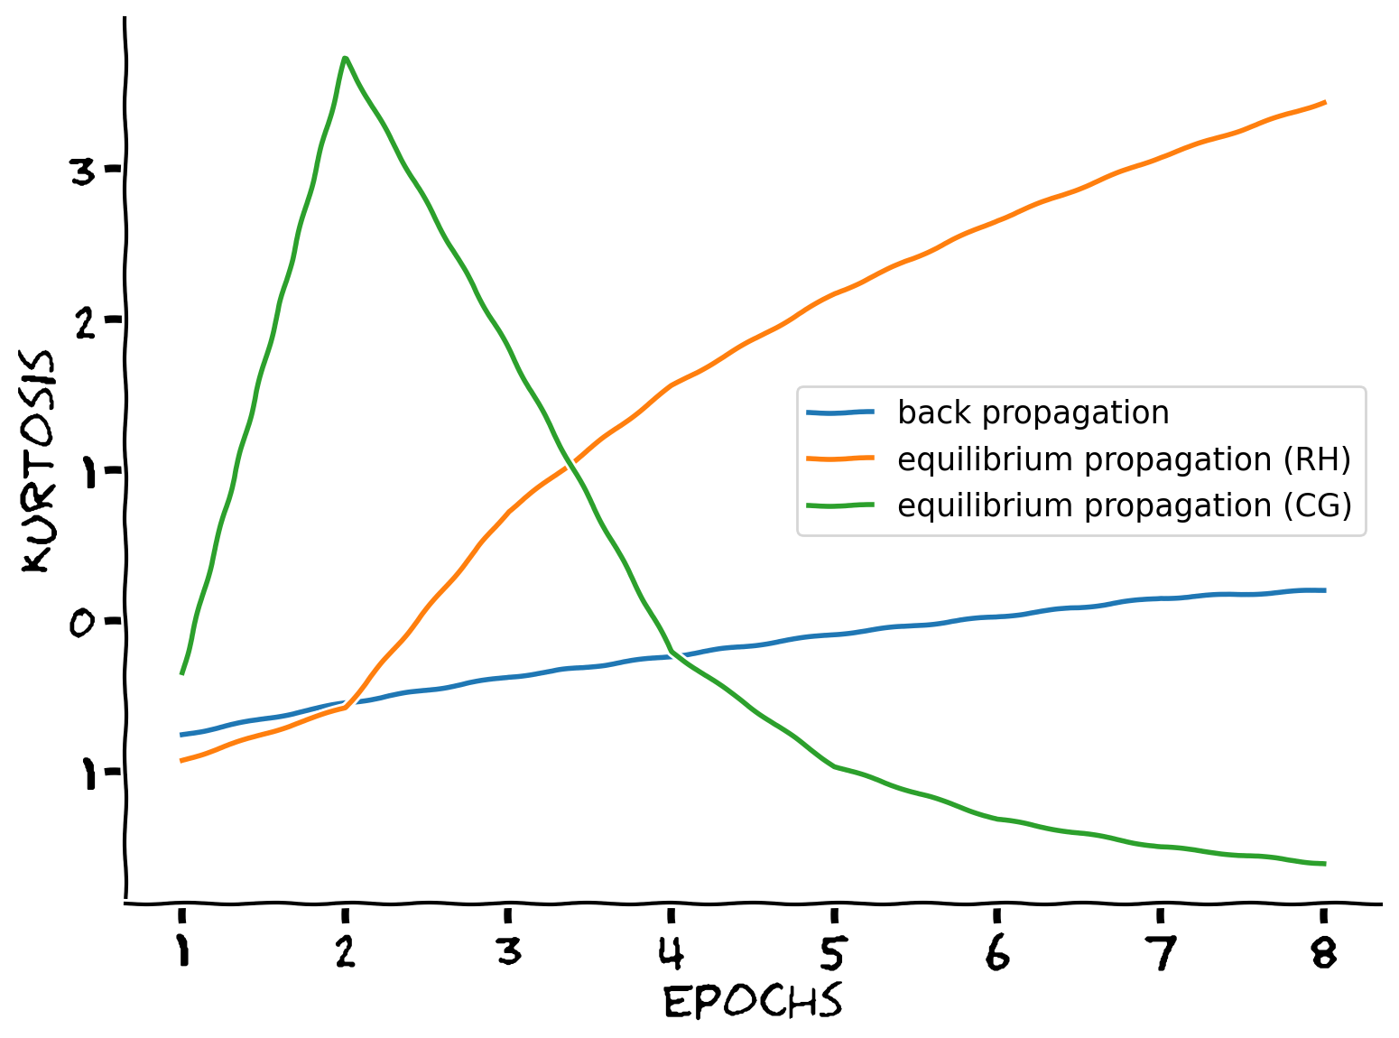
Q5: How do the distributions of input weights change with training?
* Using N = 10000 training samples
More variable
sparser
Conclusion:
With training the magnitude of input weights become larger for all 3 algorithms.
Both RH and BP input weights have increased sparsity over training epochs.
CG input weights have increased and then decreased sparsity.
RH: Restrictive Hopfield
CG: Conditional Gaussian
Notes:
Cindy

Slide 11
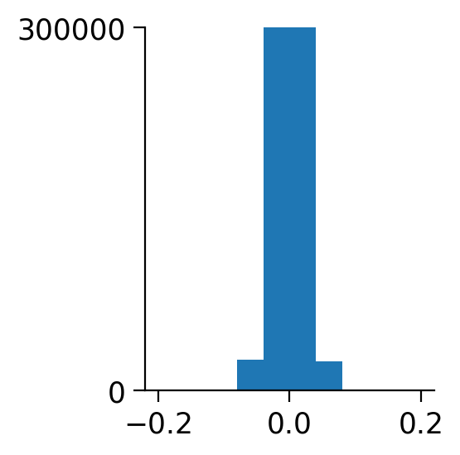
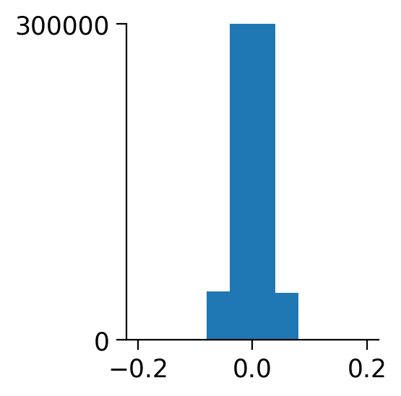
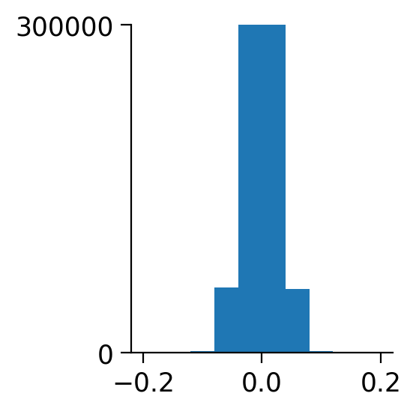
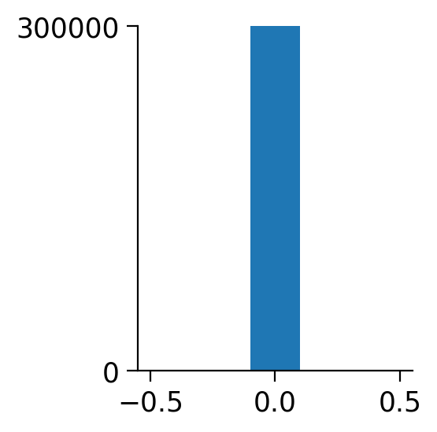
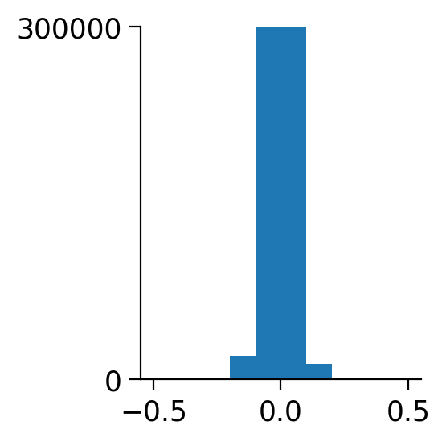
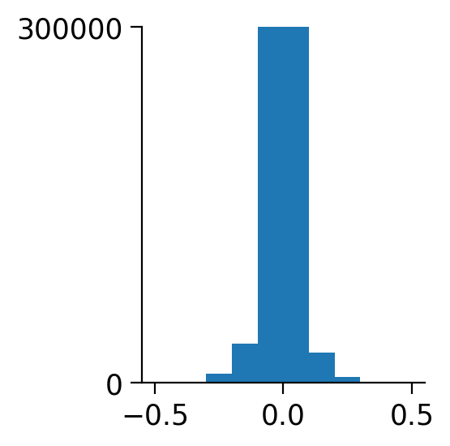
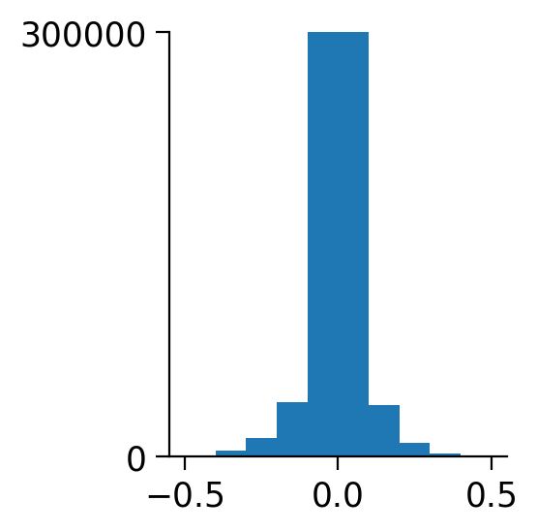
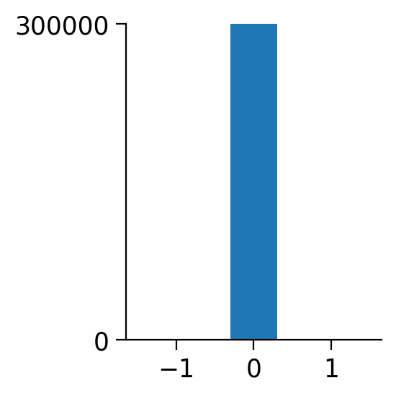
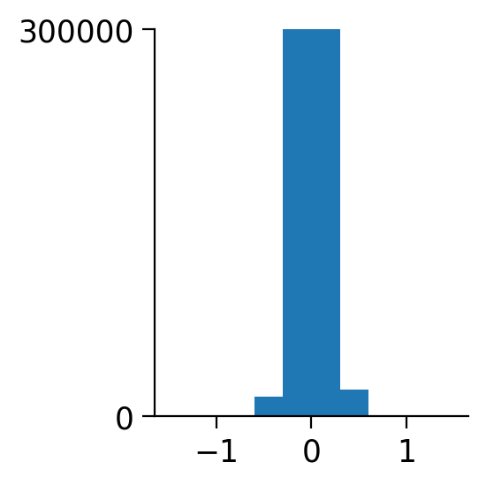
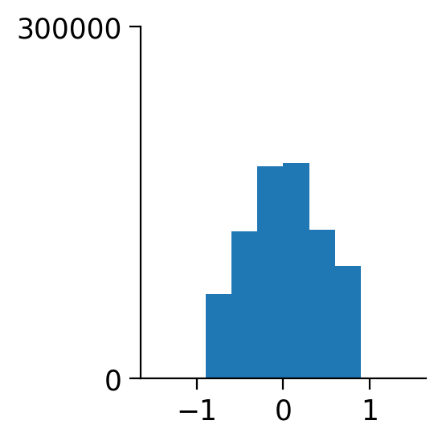
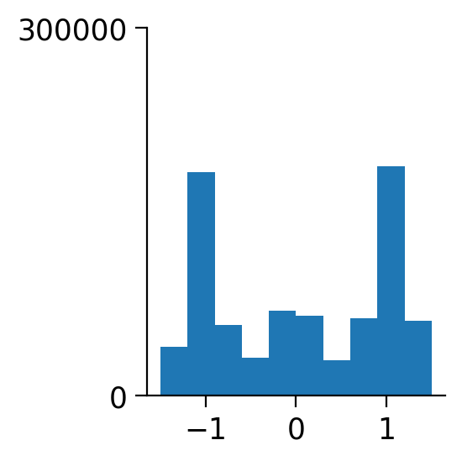
Q5: How do the distributions of input weights change with training?
Epoch = 1
Epoch = 3
Epoch = 5
Epoch = 8
* Using N = 10000 training samples
Back-propagation
Equilibrium-propagation (restrictive hopfield)
Equilibrium-propagation (conditional gaussian)
Notes:
Cindy

Slide 12
Discussion
The classification performance of models trained with equilibrium propagation was at the same level as their counterparts trained with BP, and some even surprisingly outperformed BP.
The architectures of underlying dynamics made a difference in training results. Though restricted Hopfield was deeply investigated in the original paper, it failed to achieve the performance of BP when the data size and model size were limited.
Models trained with conditional Gaussian demonstrated a weird concurrence of good results and instability in model weights.
The problem presented in the results of conditional Gaussian resembles gradient explosion, and might be related to the lack of sparsity in model weights.
Notes:
Chenyan

Slide 13
Thank you!

